Slide 1
Grain Growing at Cedar Isle Farm
An Educational Resource

Slide 2
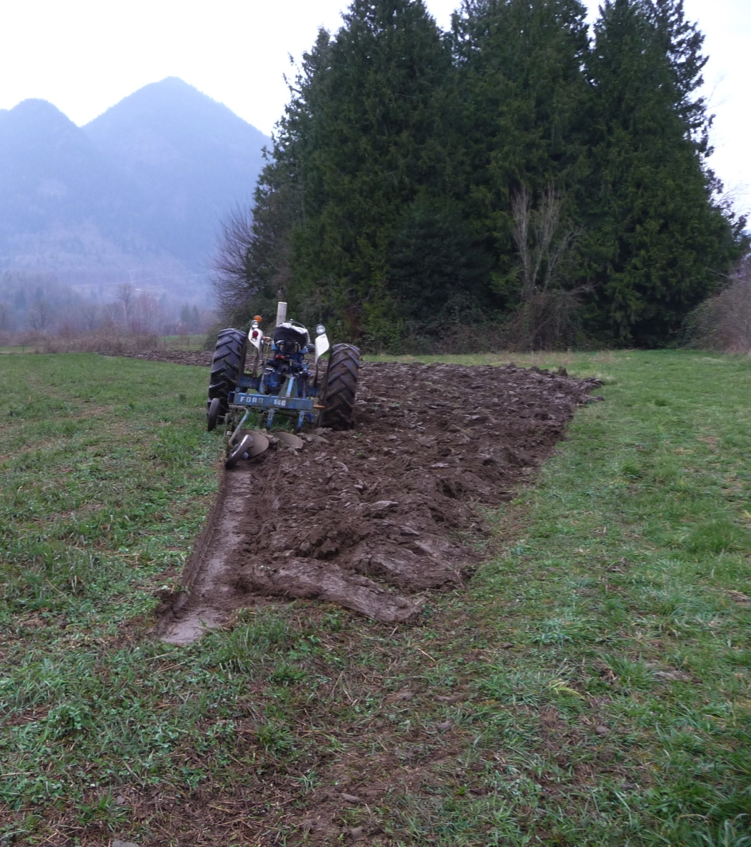
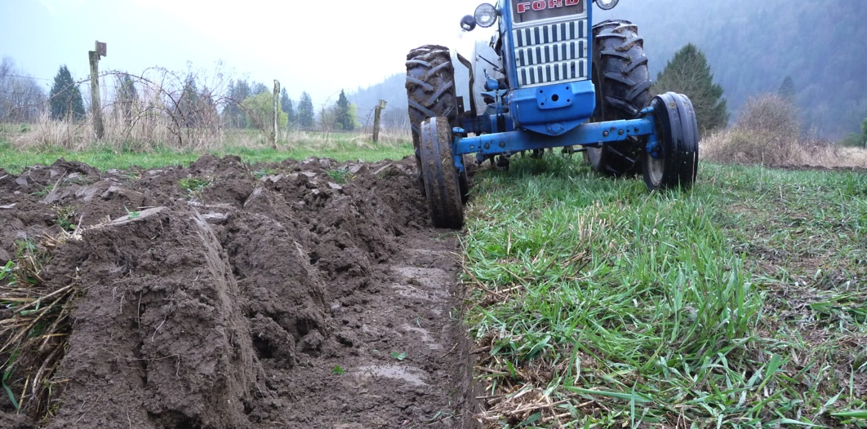
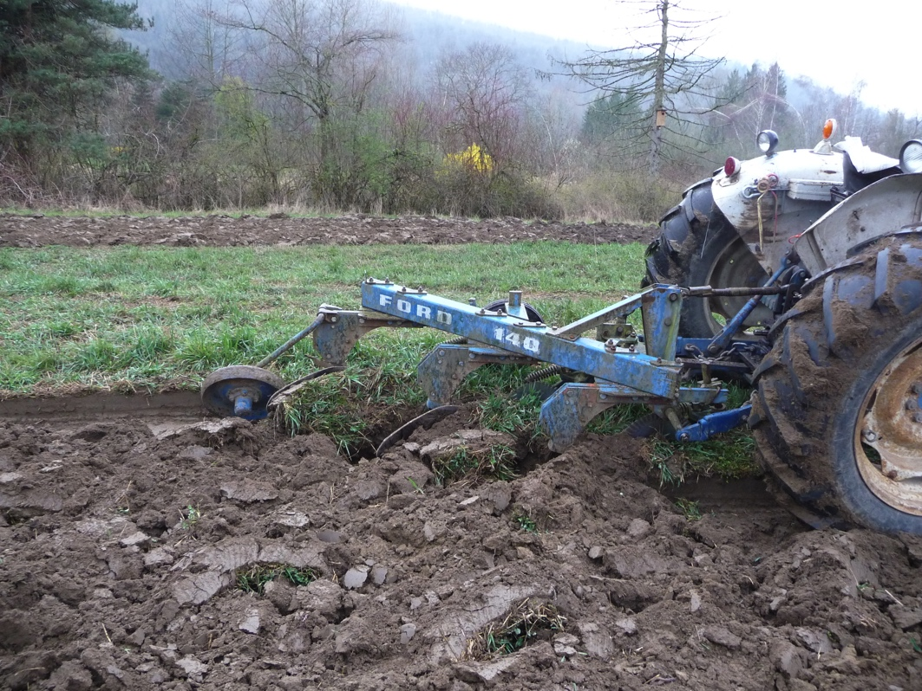
Ploughing
Notes:
Ploughing the field is the first step to prepare the field for seeding. By burying the weeds and other green growth, we add organic matter and nutrients to the soil and prepare a fresh surface for the crop. How do you prepare the soil in your garden? What tool do you use?

Slide 3
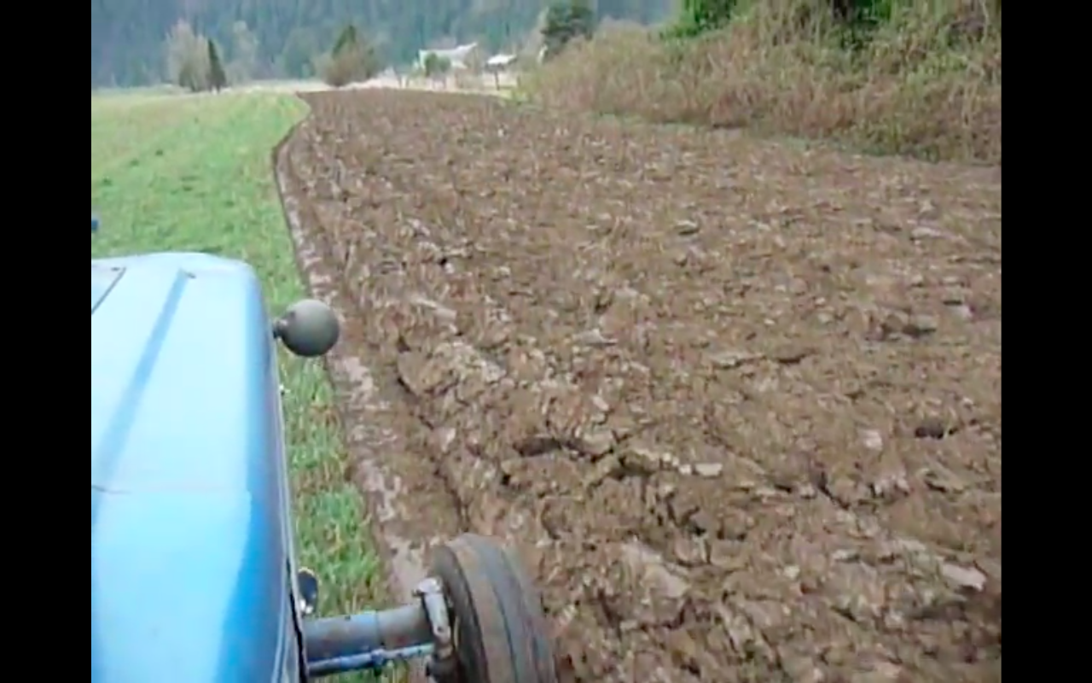
VIDEO!
Ploughing
Notes:
In this video, the plough is turning the earth to prepare for planting. Can you explain how it works?

Slide 4
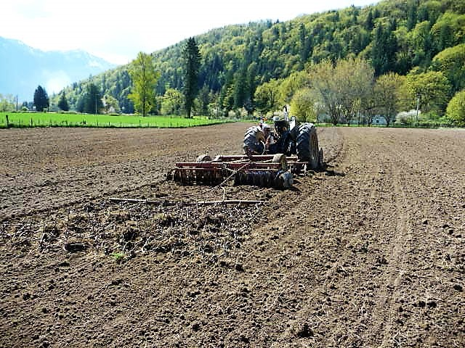
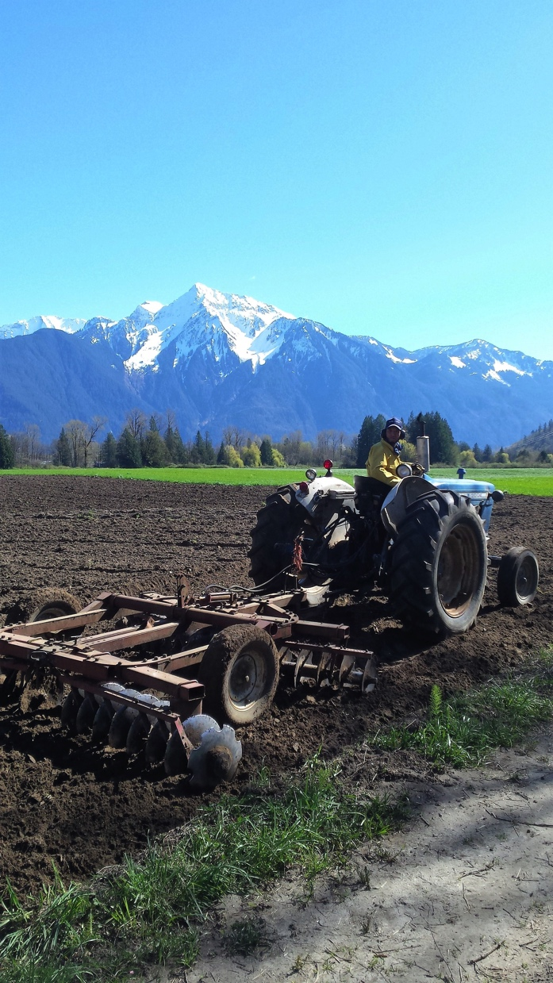
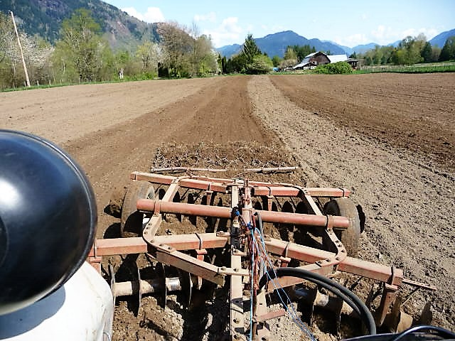
Discing
Notes:
Discing the soil helps break up clumps in the soil and leaves a smooth level surface, ready for seeding. Have you done this in your garden? What tool(s) might you use to break up and smooth the soil in a small garden? (hand, rake…)

Slide 5
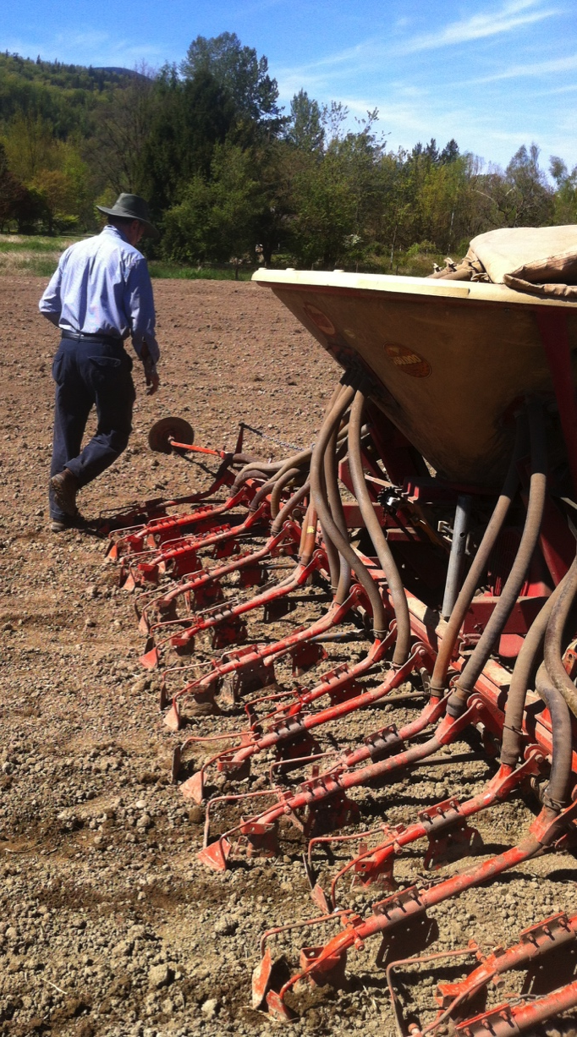
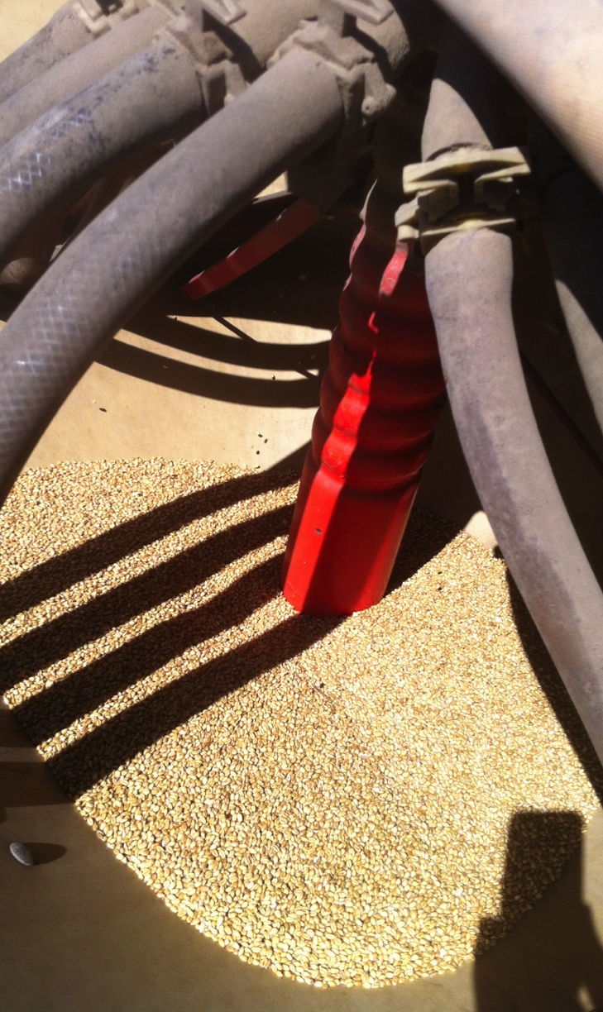
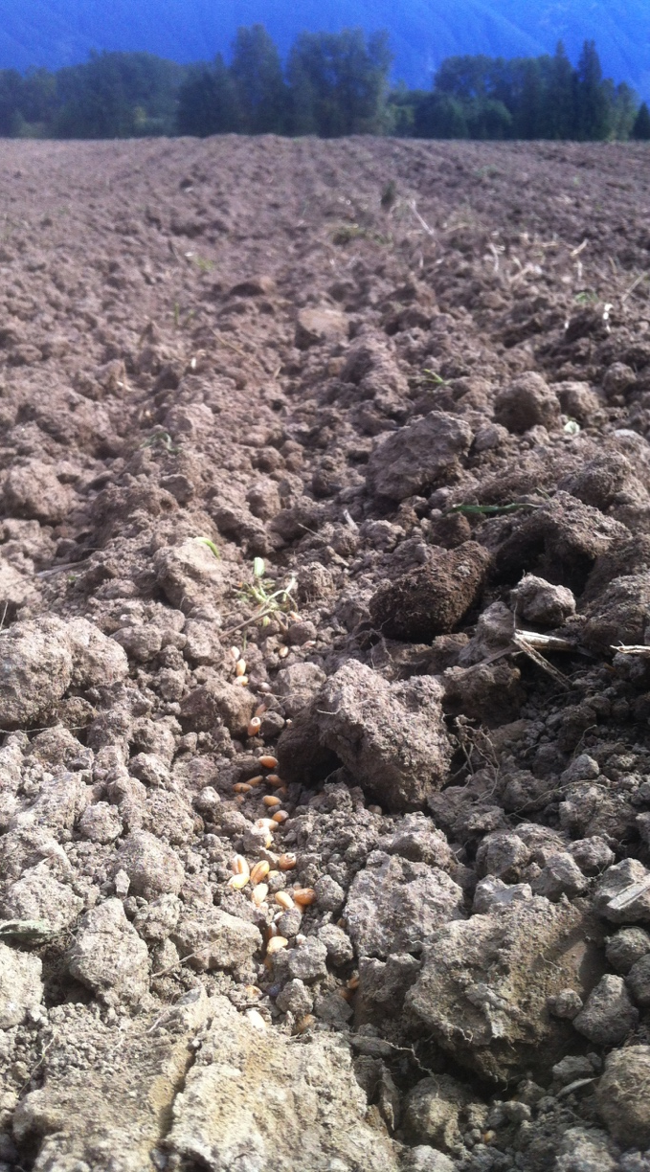
Seeding
Notes:
The seeder takes seeds from the bin and blows them down the tubes leading to the ground. The seeds are placed in evenly spaced rows and covered with a thin layer of soil, ready to sprout. How do you evenly space seeds in your garden?

Slide 6
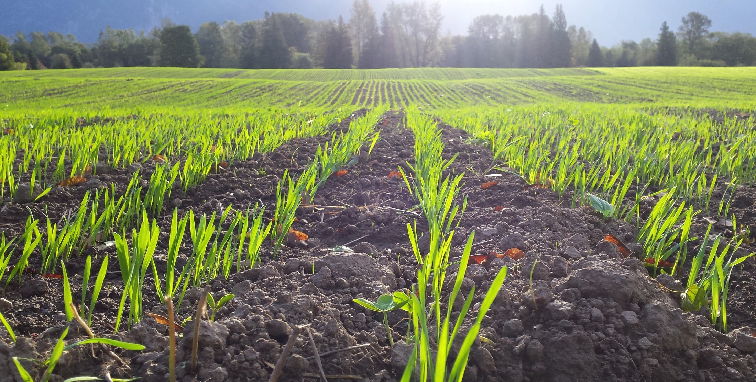
Spring!
Notes:
Springtime on the farm. The seeds have sprouted. They now look like short grass! Did you know that all grain starts out as a type of grass? Even rice and corn come from types of grass.

Slide 7
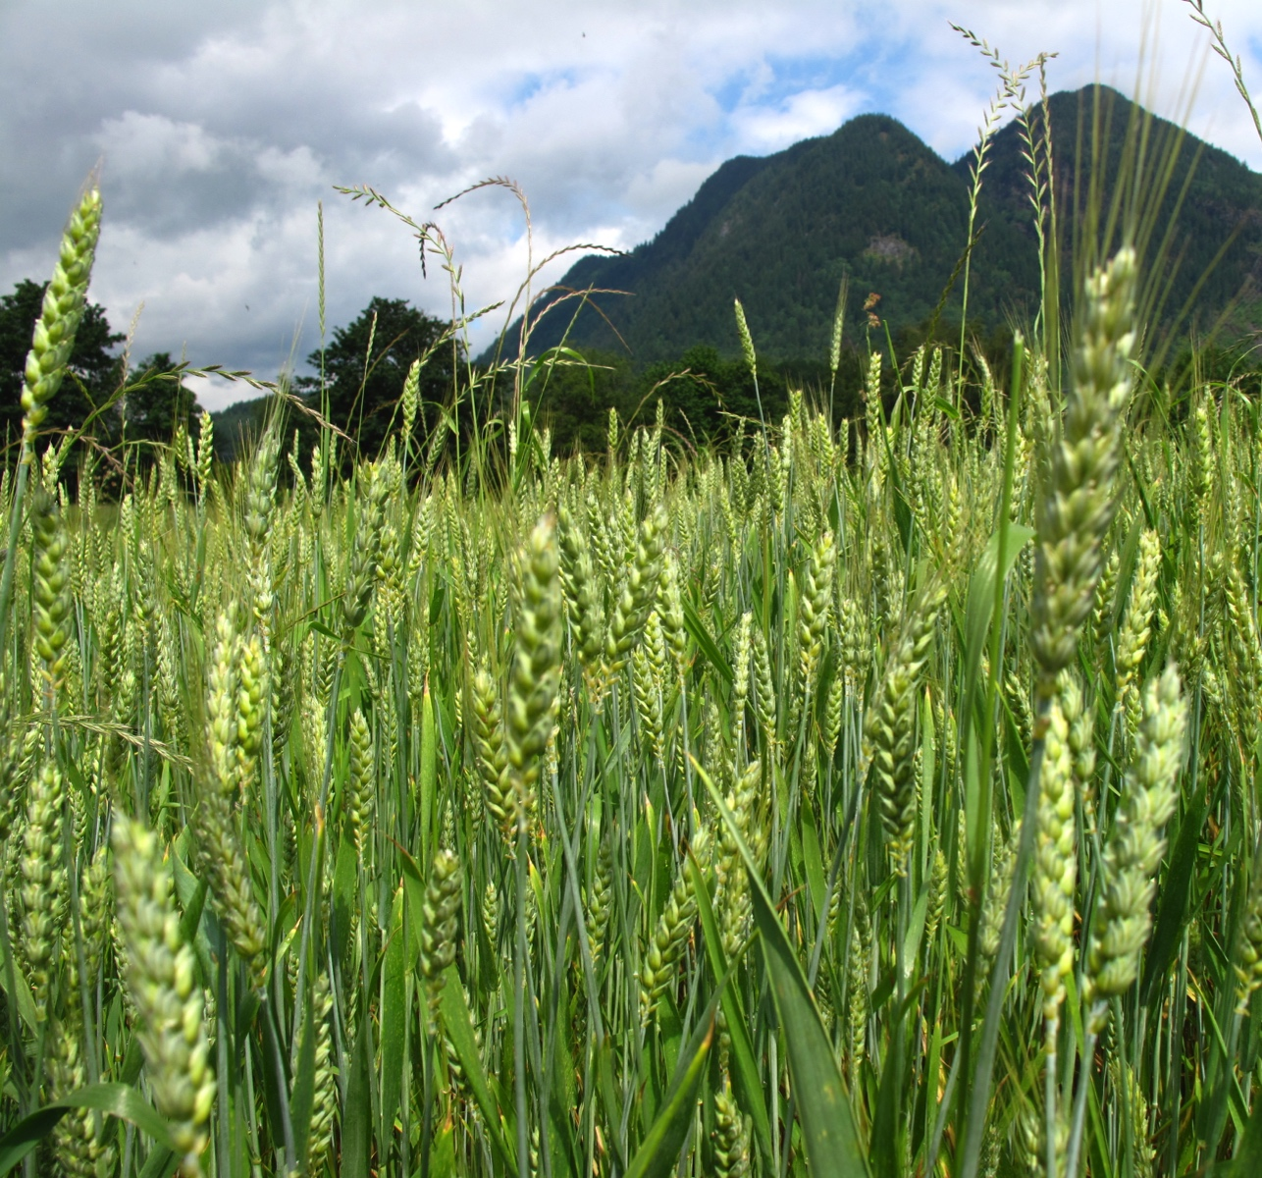
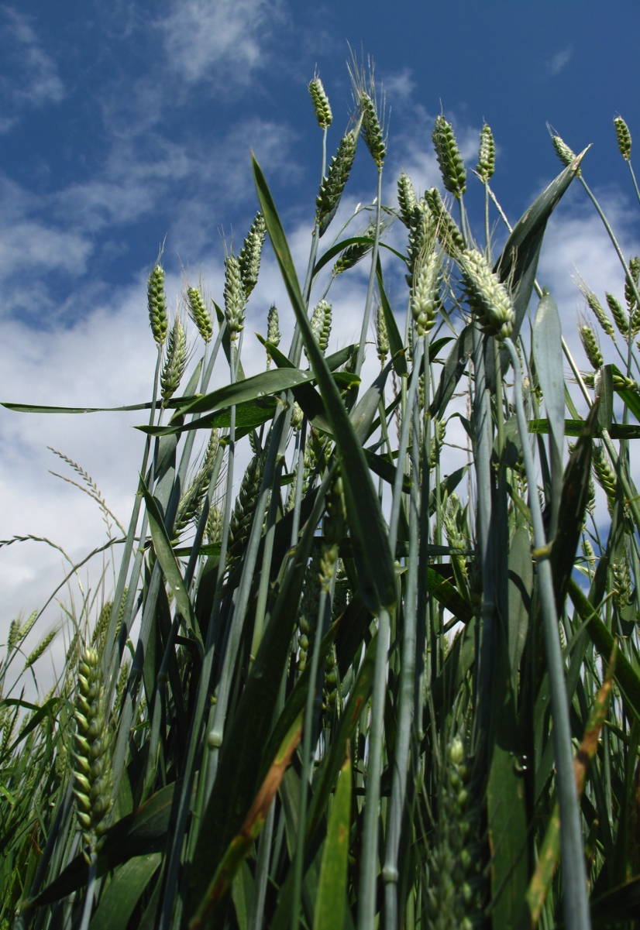
Early Summer
Notes:
Summer: The wheat plants are very tall now! They have made flowers that were pollinated and now there are seed heads developing. It is still green. Each seed head can produce up to 50 seeds. Have you ever seen grass make seed? Imagine how much see you would have in a whole field and how much seed it would take to make enough flour for a pizza crust.

Slide 8
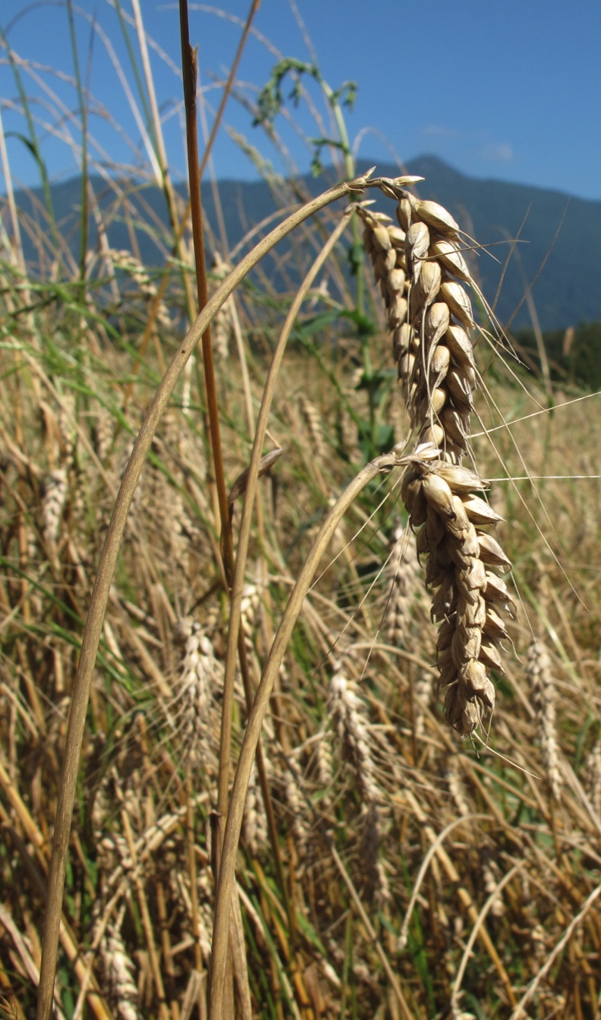
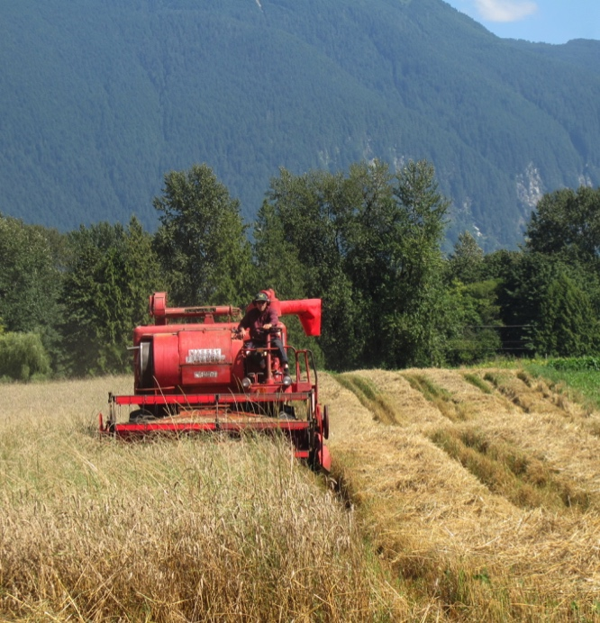
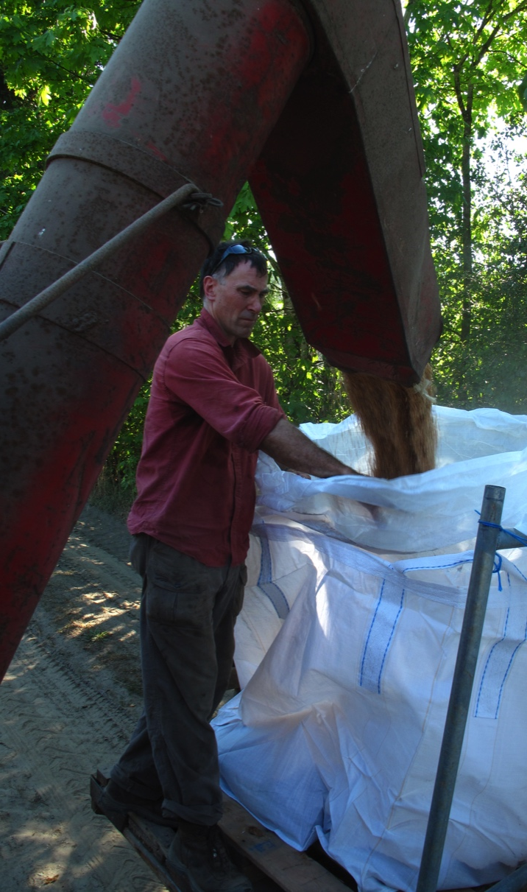
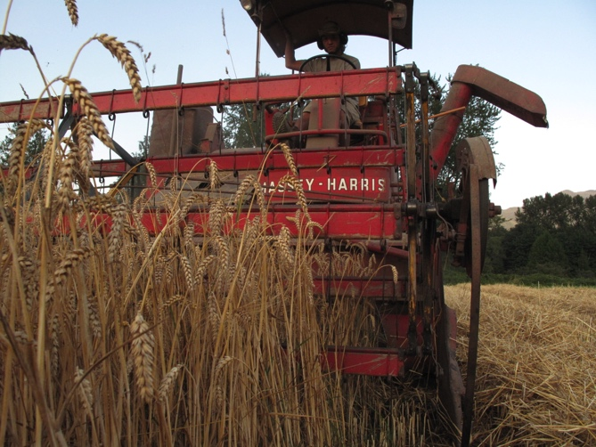
Harvesting
Notes:
As the wheat matures, it turns from green to golden brown. By late summer or early autumn, the seed heads containing the new kernels dry out and turn hard. Now they are ready to harvest! This machine is a combine. It harvests or cuts the grain plants and threshes it, stripping out the new grain and separating it from the rest of the plant.

Slide 9
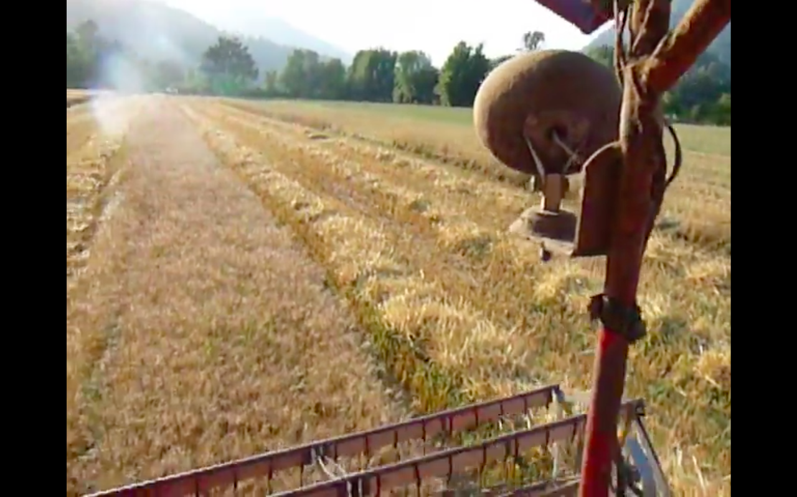
VIDEO!
Harvesting
Notes:
This video shows the grain stalks being guided into the machine, where they are cut at ground level. The plant stalks are threshed, and the grain is collected in a bin. Everything else drops out the back of the machine onto the ground.

Slide 10
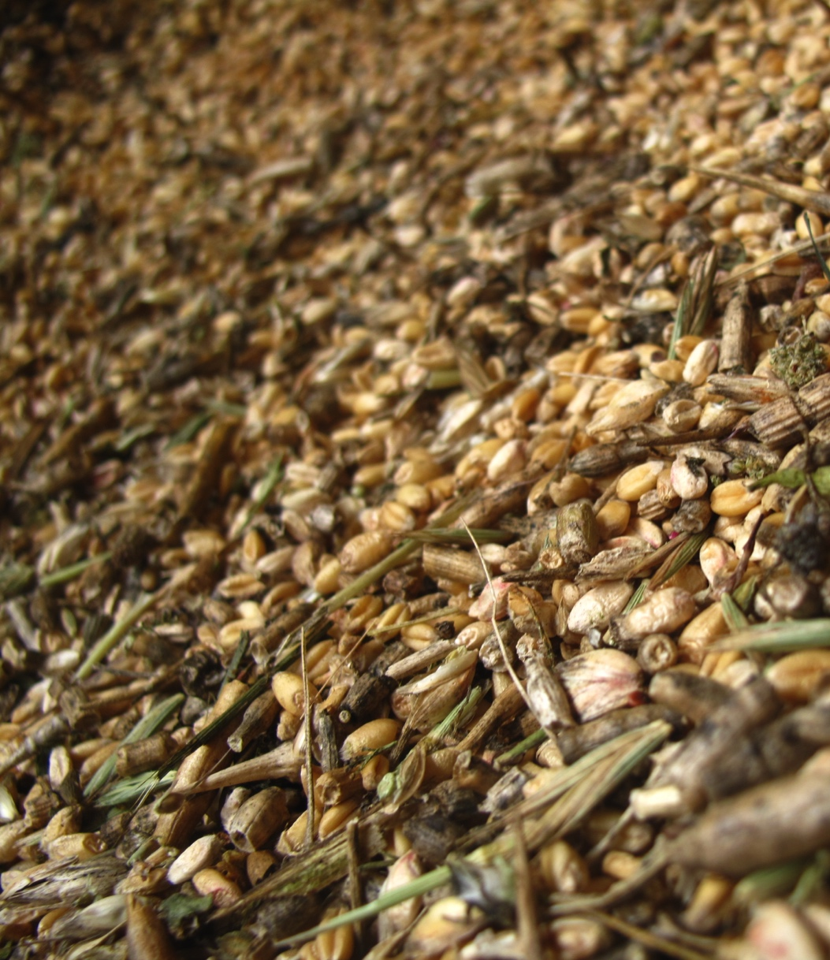
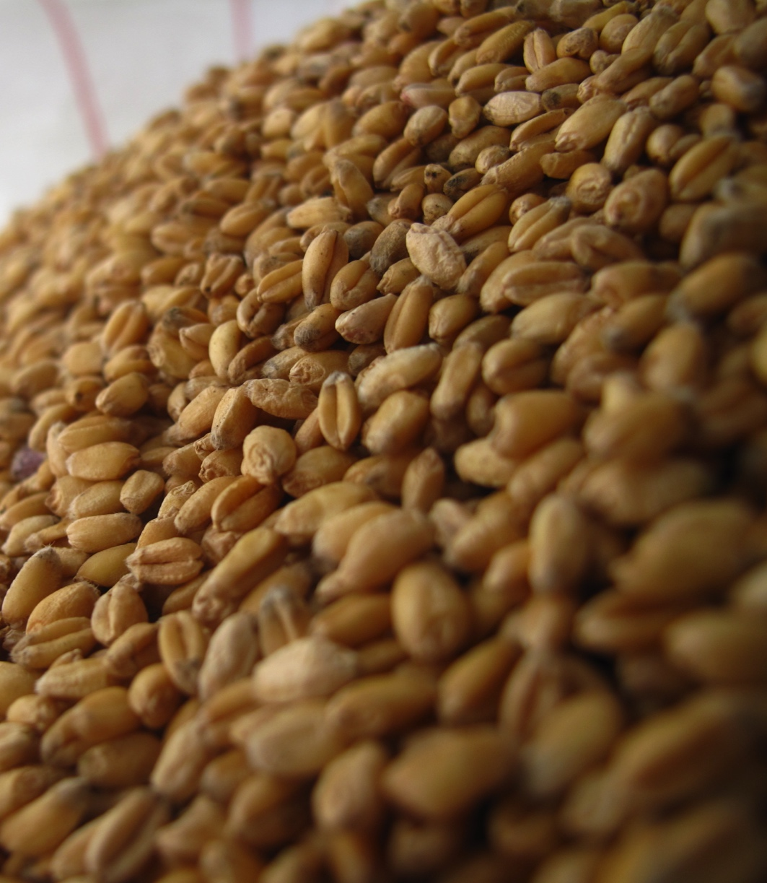
Before
After
Grain Cleaning
Notes:
The harvested grain often contains weed seeds and small bits of wheat stalks and chaff that have to be removed before the grain is stored or used. “Separating the wheat from the chaff…” is called cleaning the grain. How would you separate the wheat from the chaff if you had no machine? How long would this take?

Slide 11
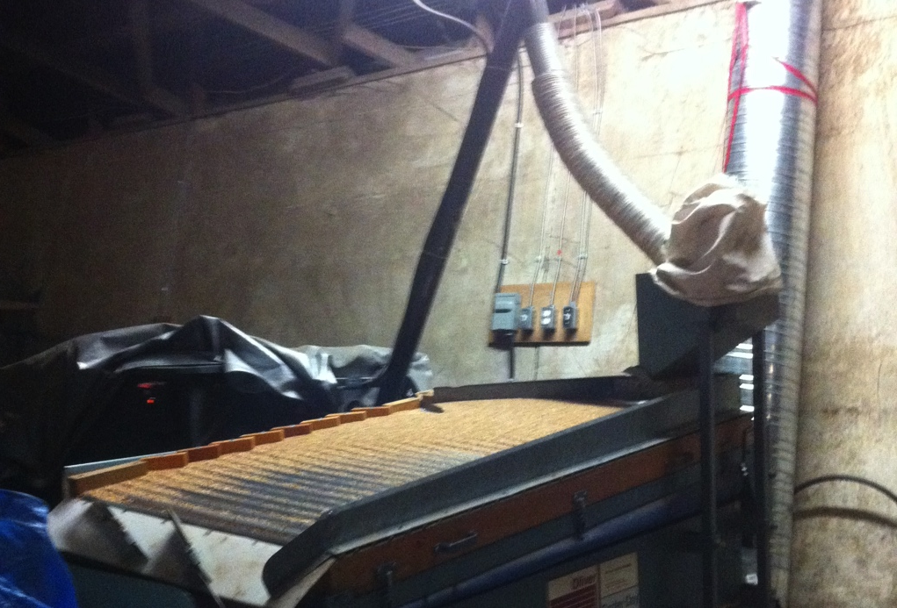
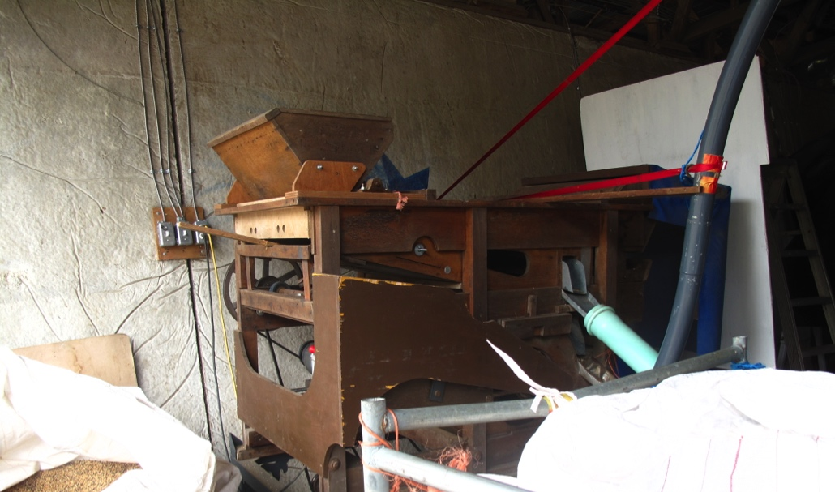
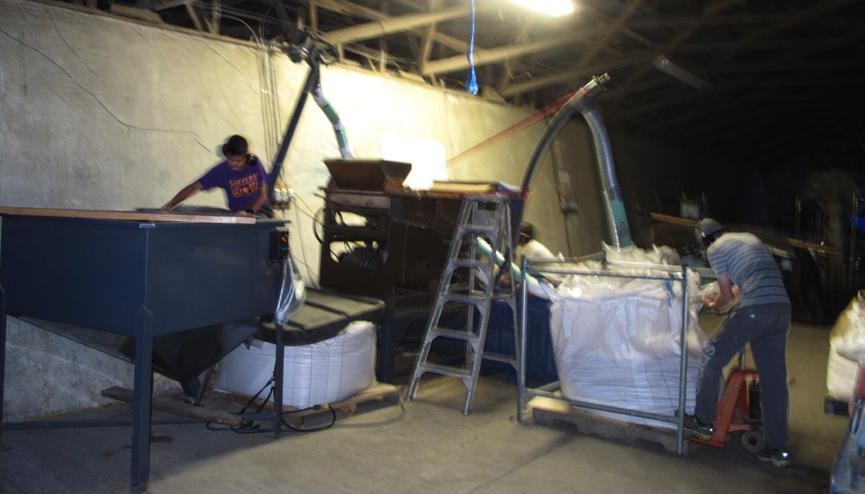
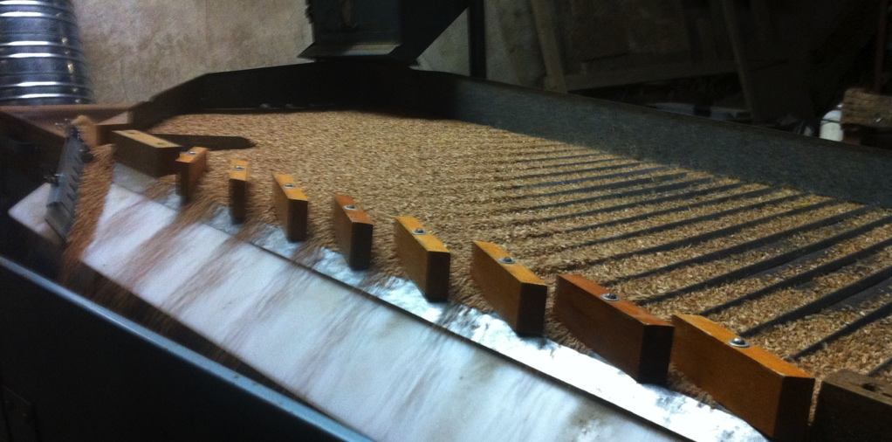
Clipper, the seed cleaner
Gravity Table
Grain Cleaning
Notes:
The seed cleaner and gravity table sieve and blow out weed seeds and other unwanted material from the grain. When we are finished there is clean grain that can be milled into flour! The following videos will show how these machines work.

Slide 12
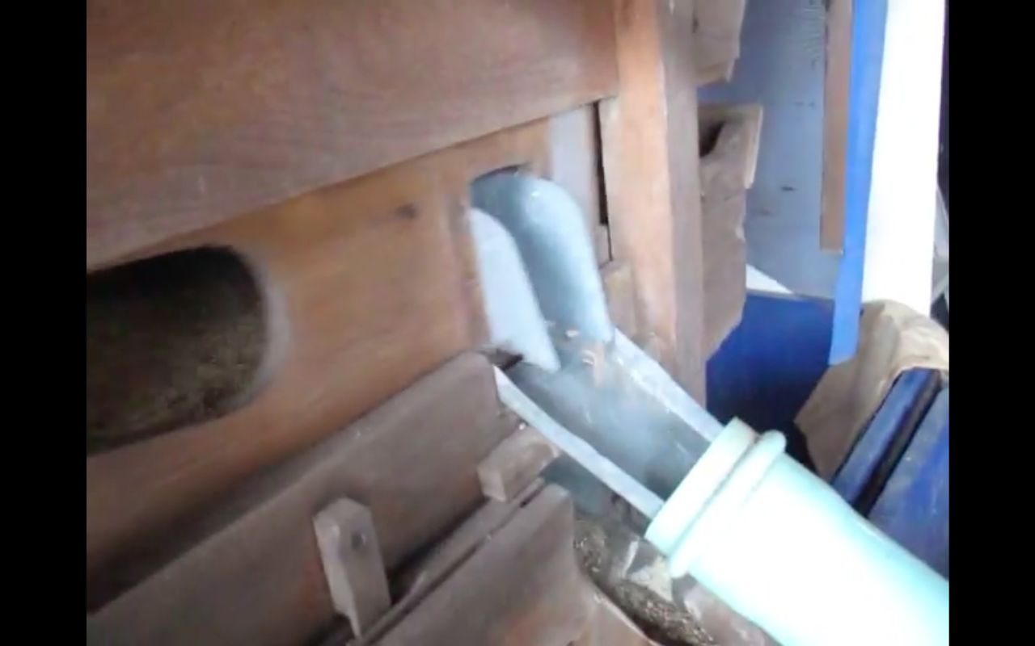
VIDEO!
Grain Cleaning
Clipper, the seed cleaner
Notes:
In this video, Clipper the old seed cleaner removes dark-coloured weed seeds from the white wheat.

Slide 13
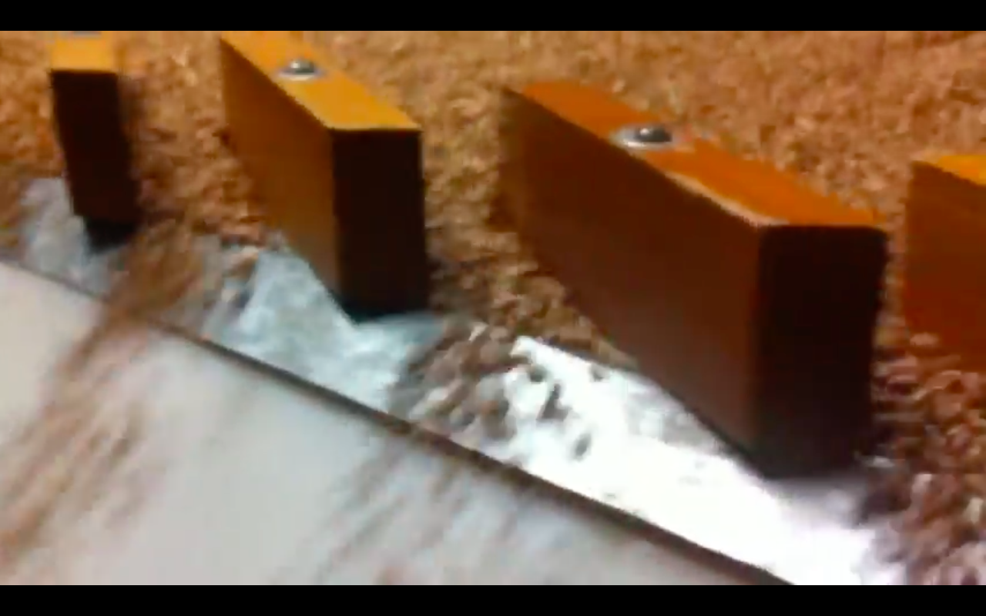
VIDEO!
Grain Cleaning
Gravity Table
Notes:
The gravity table separates material based on its density. The wheat is heavier and flows through the gates. The lighter weed seeds rise to the top and flow out the back of the machine. This is a good way to get very pure seed for next year!

Slide 14
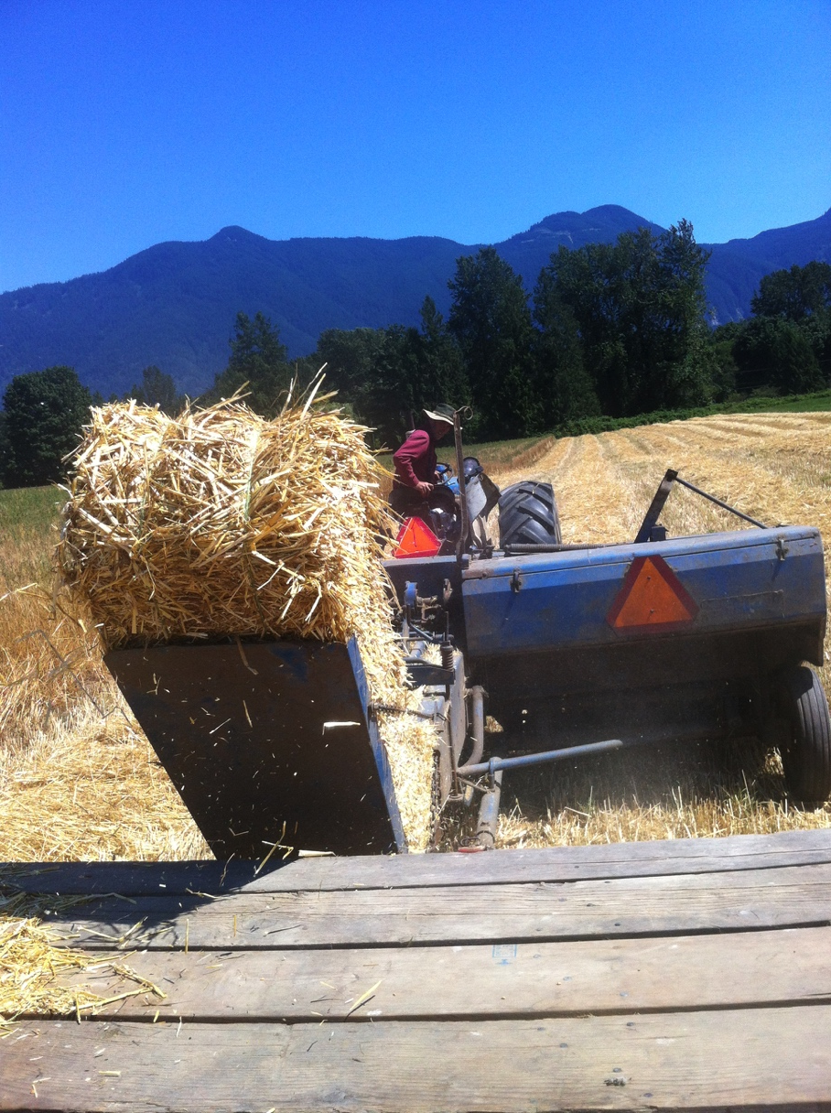
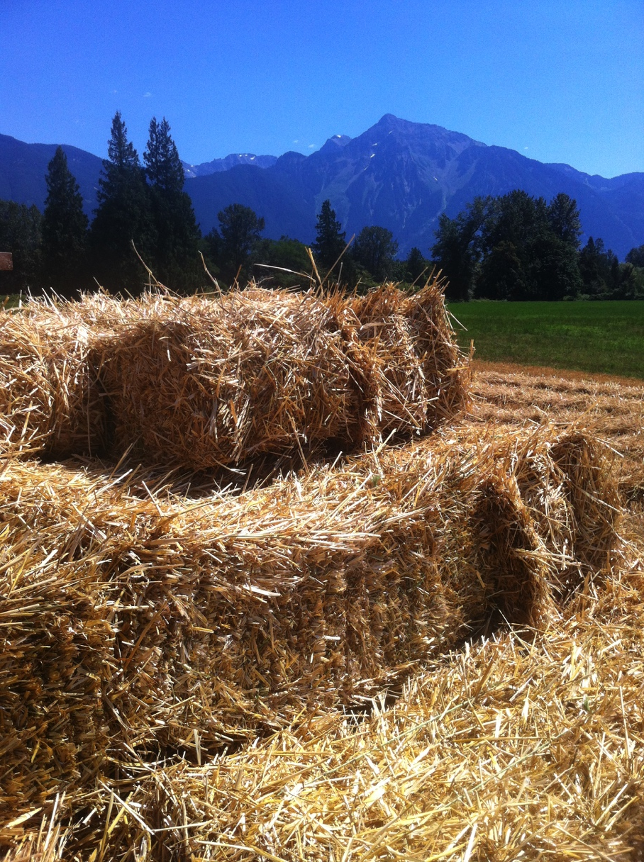
Straw Baling
Notes:
After the grain kernels are removed, the golden coloured grain stalks that were left on the field are also valuable. They are pressed into bales to be used as animal bedding, or for mulching strawberries and around other garden plants to control weeds and retain soil moisture. What other uses for straw can you think of? Why is it so important that the straw gets used? (financial value to farmer, decreases waste, useful for many things)

